Slide 1
Tableau Insights
Parmeet singh Dang

Slide 2
Agenda
Problem Statement
Factors
Architectural Diagram
Demo

Slide 3
Problem Statement
Sales Company wants to know insight about revenues and their year on year impact.
They are also interested in knowing which products are out performing and who are their crucial customers.
They are also interested in knowing which zones and regions are crucial for business
They want to improvise business in non-performing cities and regions.

Slide 4
Focus Factors
Revenue
Sales
Qty
Customers
Products

Slide 5
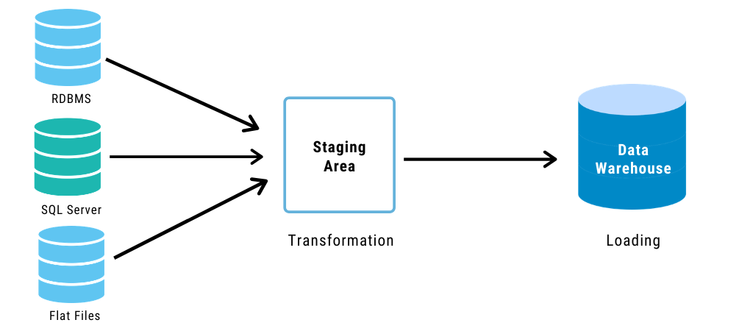
Database Architecture

Slide 6




Architectural Diagram
ETL Operations
Analyze, Visualize &
find patterns

Slide 7
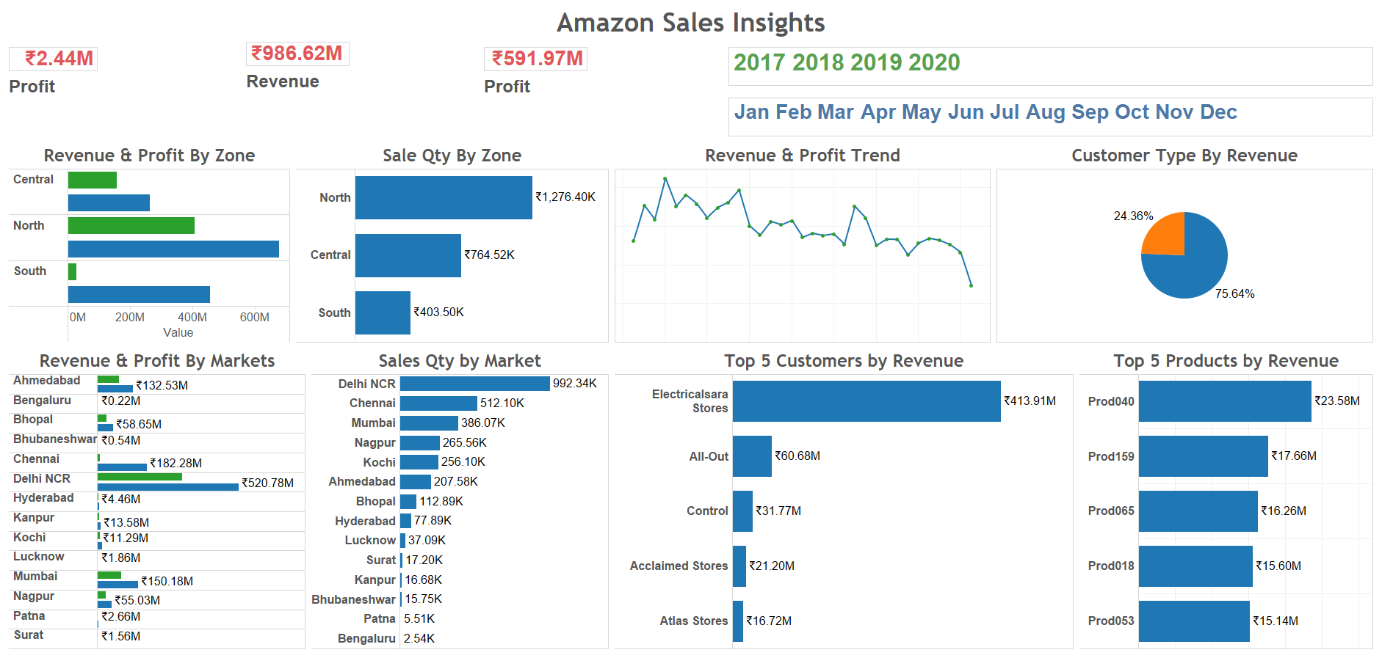

Slide 8
Demo

